Slide 1
MULTIPLE ACCESS PROTOCOL

Slide 2
MULTIPLE ACCESS
If there is a dedicated link between the sender and the receiver then data link control layer is sufficient, however if there is no dedicated link present then multiple stations can access the channel simultaneously.
Hence multiple access protocols are required to decrease collision and avoid crosstalk.
Protocols are required for sharing data on non dedicated channels. Multiple access protocols can be subdivided further as

Slide 3
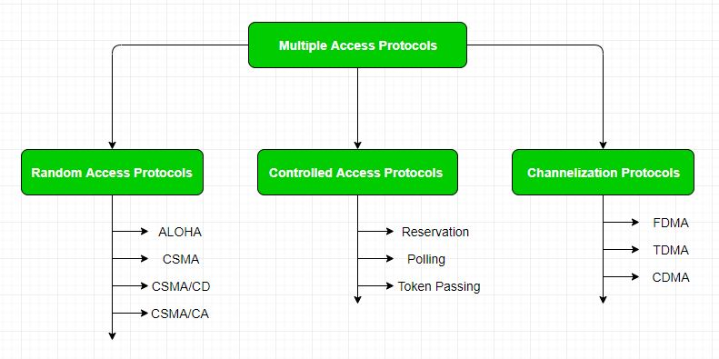

Slide 4
RANDOM ACCESS
In this, all stations have same superiority that is no station has more priority than another station.
Any station can send data depending on medium’s state( idle or busy). It has two features:
There is no fixed time for sending data
There is no fixed sequence of stations sending data

Slide 5
ALOHA
It was designed for wireless LAN but is also applicable for shared medium. In this, multiple stations can transmit data at the same time and can hence lead to collision and data being garbled.
PURE ALOHA
SLOTTED ALOHA

Slide 6
PURE ALOHA
When a station sends data it waits for an acknowledgement.
If the acknowledgement doesn’t come within the allotted time then the station waits for a random amount of time called back-off time (Tb) and re-sends the data.
Since different stations wait for different amount of time, the probability of further collision decreases.

Slide 7
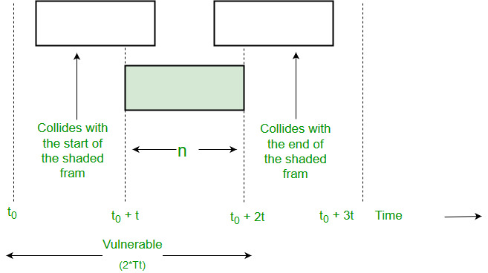
Throughput= G * e^-2G maximum throughput=0.184(G=0.5) G=no of station on same time

Slide 8
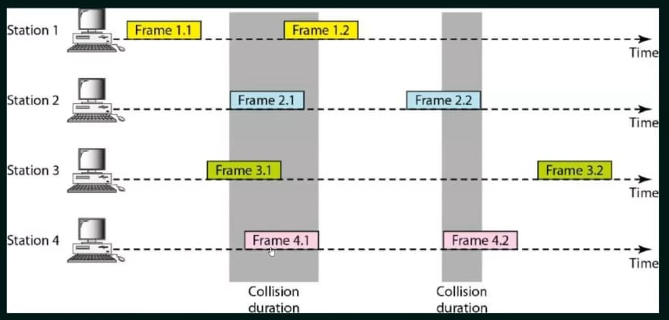
Frames-pure aloha

Slide 9
SLOTTED ALOHA
This is quite similar to Pure Aloha, differing only in the way transmissions take place. Instead of transmitting right at demand time, the sender waits for some time.
In slotted ALOHA, the time of the shared channel is divided into discrete intervals called Slots
If any station is not able to place the frame onto the channel at the beginning of the slot, it has to wait until the beginning of the next time slot.
There is still a possibility of collision if two stations try to send at the beginning of the same time slot. But still, the number of collisions that can possibly take place is reduced by a large margin and the performance becomes much well compared to Pure Aloha.

Slide 10
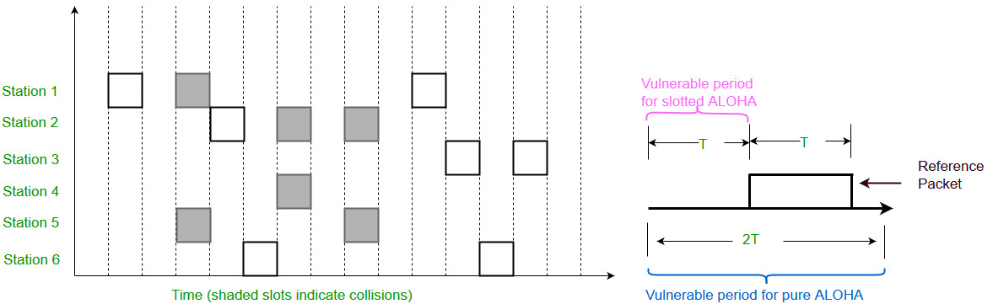

Slide 11
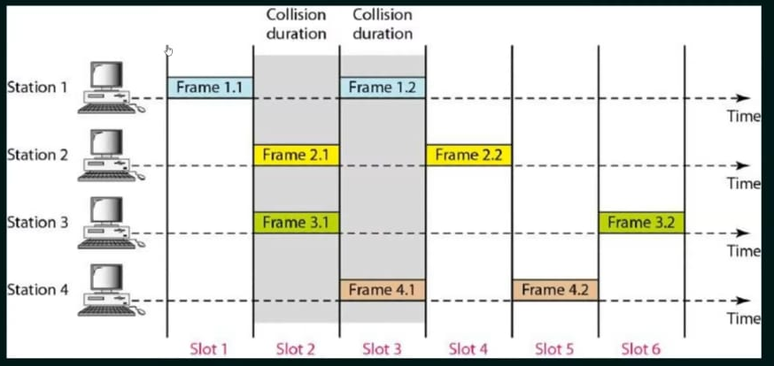
Frames-SlottedALOHA

Slide 12
